Slide 1


Kotlin Basic Types
Strings

Slide 2
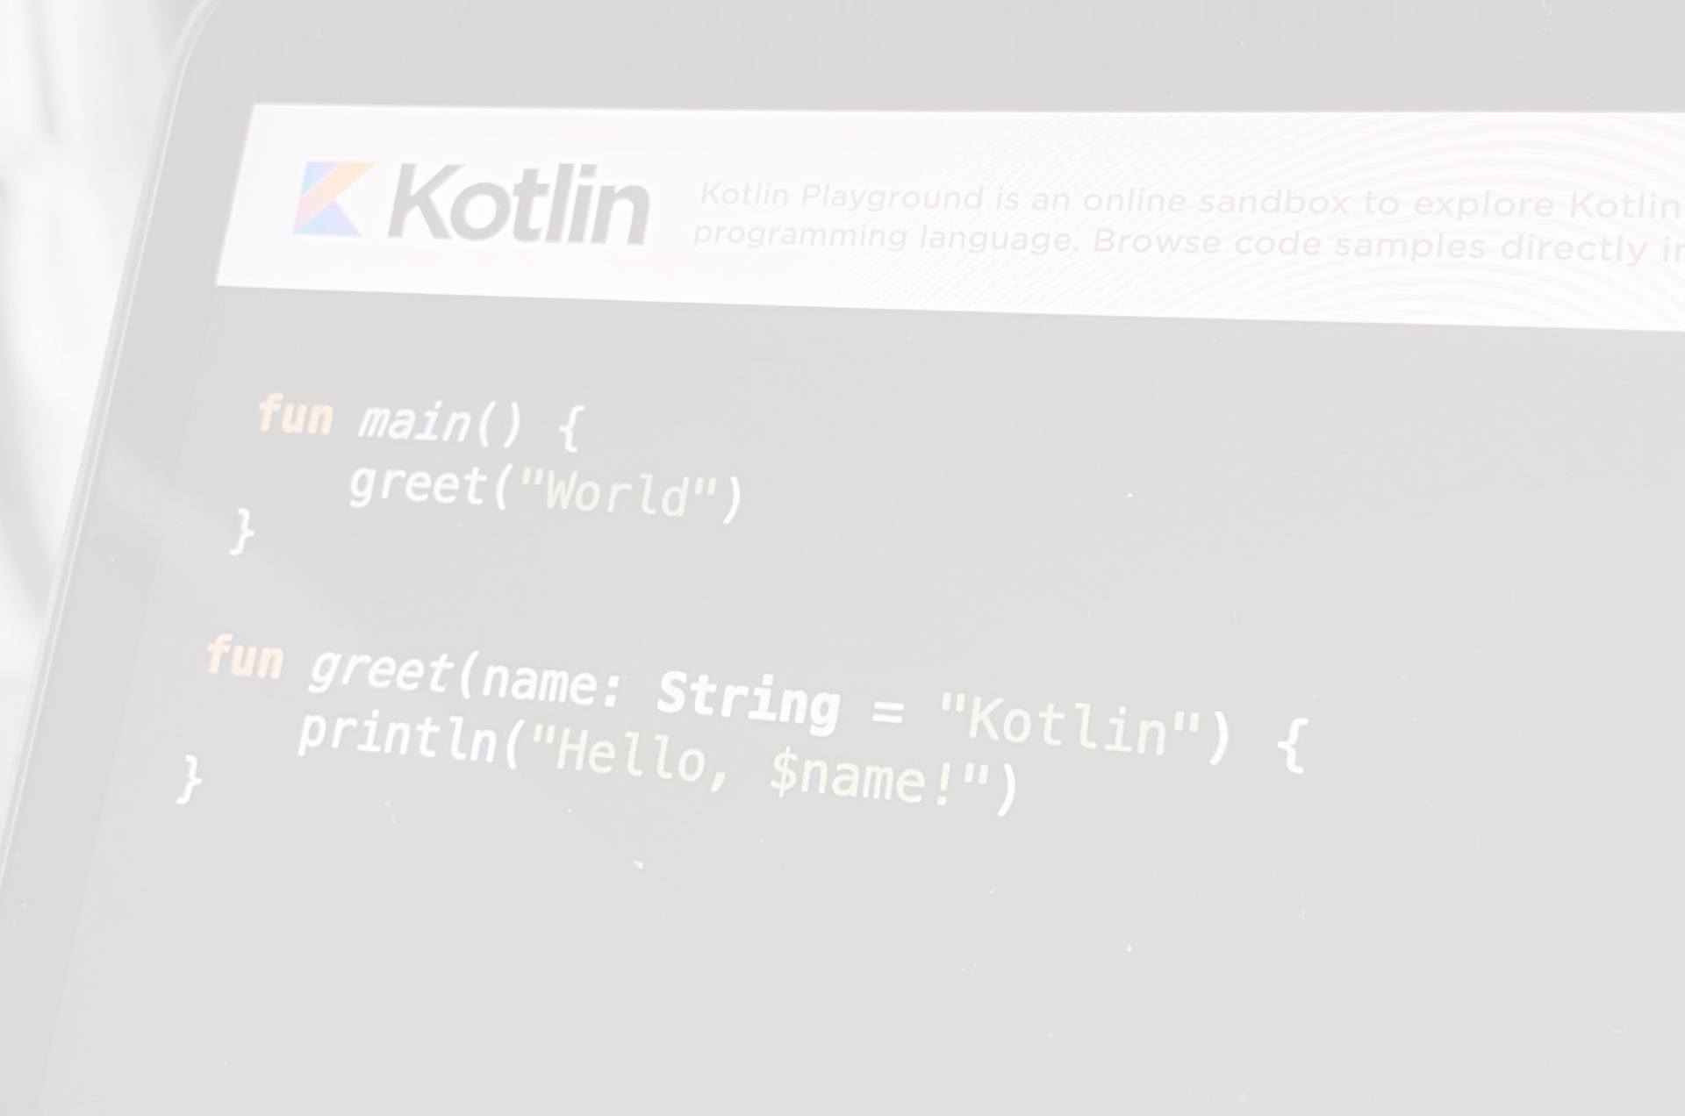
Generally, a string value is a sequence of characters in double quotes ("):
val str = "abcd 123"
Elements of a string are characters that you can access via the indexing operation: s[i]. You can iterate over these characters with a for loop:
for (c in str) {
println(c)
}
Strings are immutable. Once you initialize a string, you can't change its value or assign a new value to it. All operations that transform strings return their results in a new String object, leaving the original string unchanged:
val str = "abcd"
// Creates and prints a new String object
println(str.uppercase())
// ABCD
// The original string remains the same
println(str)
// abcd
To concatenate strings, use the + operator. This also works for concatenating strings with values of other types, as long as the first element in the expression is a string:
val s = "abc" + 1
println(s + "def")
// abc1def

Slide 3

String Literals﻿
Escaped strings﻿
Escaped strings can contain escaped characters. Here's an example of an escaped string:
val s = "Hello, world!\n"
Escaping is done in the conventional way, with a backslash (\).
Multiline strings﻿
Multiline strings can contain newlines and arbitrary text. It is delimited by a triple quote ("""), contains no escaping and can contain newlines and any other characters:
val text = """
for (c in "foo")
print(c)
""
To remove leading whitespace from multiline strings, use the trimMargin() function:
val text = """
|Tell me and I forget.
|Teach me and I remember.
|Involve me and I learn.
|(Benjamin Franklin)
""".trimMargin()
By default, a pipe symbol | is used as margin prefix, but you can choose another character and pass it as a parameter, like trimMargin(">").

Slide 4
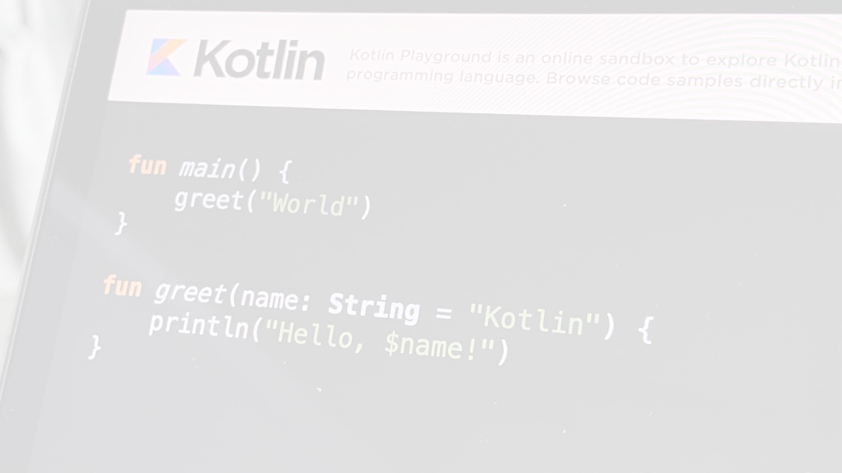
String Templates﻿
String literals may contain template expressions – pieces of code that are evaluated and whose results are concatenated into the string. A template expression starts with a dollar sign ($) and consists of either a name:
val i = 10
println("i = $i")
// i = 10
or an expression in curly braces:
val s = "abc"
println("$s.length is ${s.length}")
// abc.length is 3
You can use templates both in multiline and escaped strings. To insert the dollar sign $ in a multiline string (which doesn't support backslash escaping) before any symbol, which is allowed as a beginning of an identifier, use the following syntax:
val price = """
${'$'}_9.99
"""

Slide 5
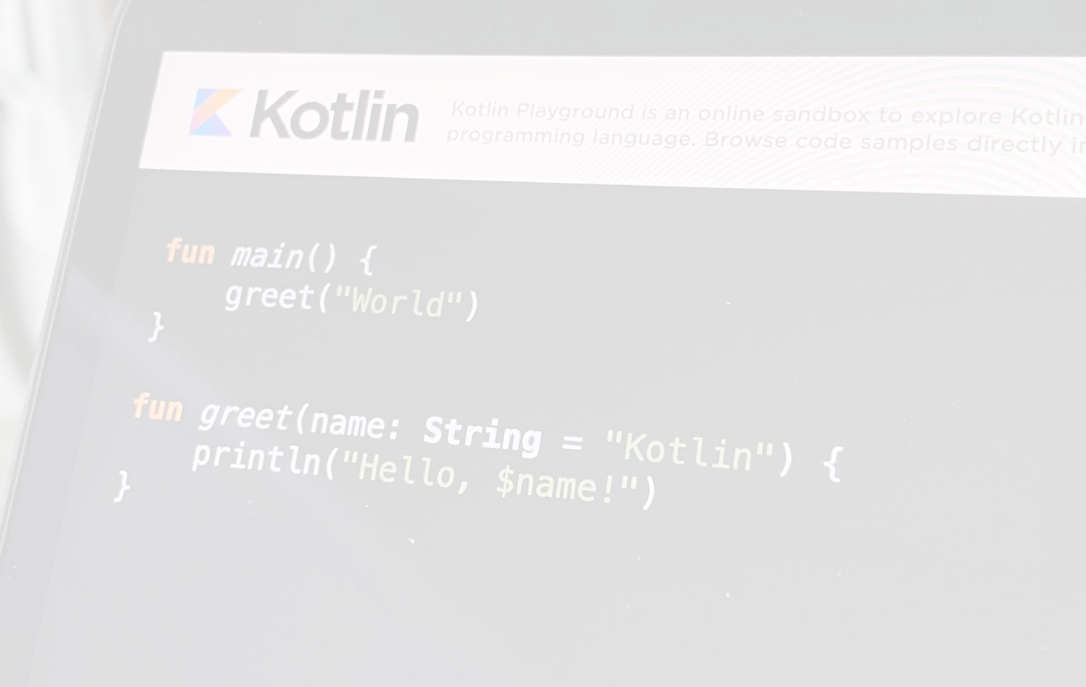
String Formatting﻿
To format a string to your specific requirements, use the String.format() function.
The String.format() function accepts a format string and one or more arguments. The format string contains one placeholder (%) for each remaining argument, followed by format specifiers. Format specifiers are formatting instructions for the respective argument. In the output, each argument fills its corresponding placeholder in the defined format:
// Formats to add zeroes and make a length of seven
val integerNumber = String.format("%07d", 31416)
println(integerNumber)
// 0031416
// Formats with four decimals and sign
val floatNumber = String.format("%+.4f", 3.141592)
println(floatNumber)
// +3.1416
// Formats with uppercase for two placeholders
val helloString = String.format("%S %S", "hello", "world")
println(helloString)
// HELLO WORLD
The String.format() function provides similar functionality to string templates. However, the String.format() function is more versatile because there are more formatting options available.
In addition, you can assign the format string from a variable. This can be useful when the format string changes, for example, in localization cases that depend on the user locale.
Be careful when using the String.format() function because it can be easy to mismatch the number or position of the arguments with their corresponding placeholders.

